Slide 1
Wireless Digital Communications
Topic 6
MIMO

Slide 2
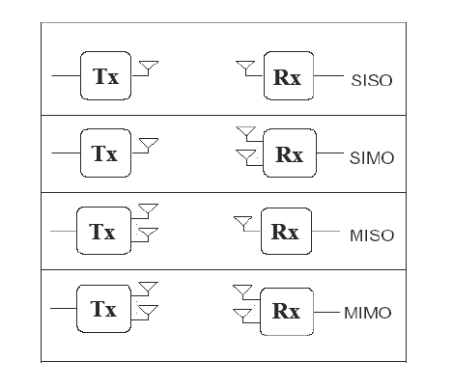
Multiple Antennas (Adding Spatial Dimension)

Slide 3
Single-User/Multi-User Spatial Multiplexing

Slide 4
MIMO Principles

Slide 5
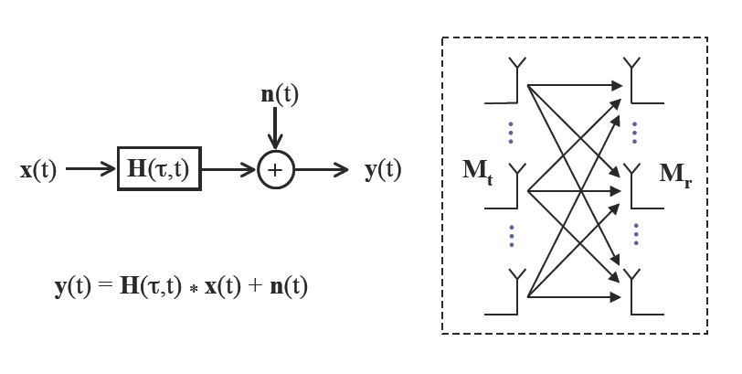
MIMO Principles

Slide 6
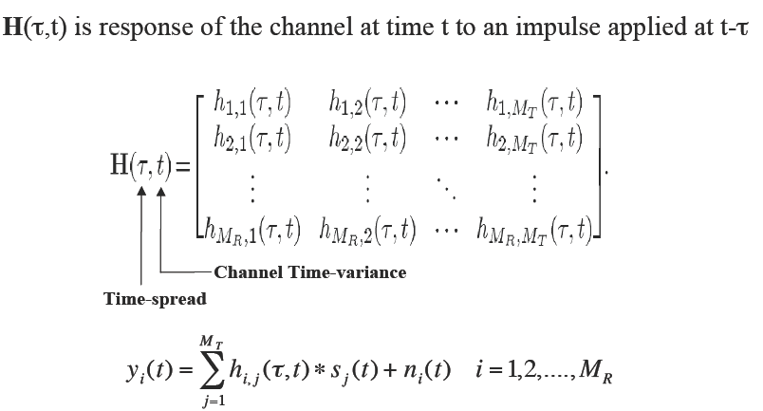
MIMO Principles

Slide 7

Narrowband MIMO System (Flat Fading Channel)

Slide 8
Narrowband MIMO System (Flat Fading Channel)

Slide 9
MIMO Performance Improvements

Slide 10
MIMO Performance Improvements

Slide 11
MIMO Performance Improvements

Slide 12
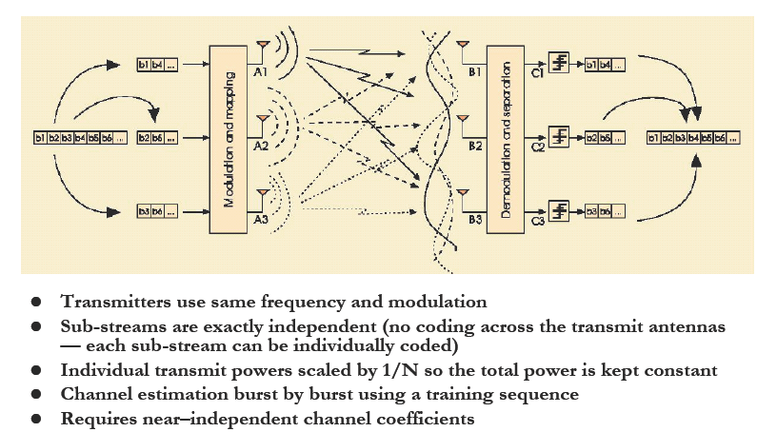
Spatial Multiplexing Gain

Slide 13
Spatial Multiplexing Gain

Slide 14
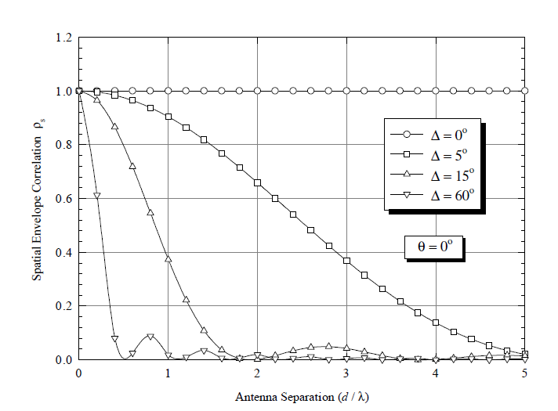
Spatial Envelope Correlation v.s. Antenna Spacing

Slide 15
Space-Time Fading

Slide 16
Space-Time Fading

Slide 17
MIMO Channel Parallel Decomposition
Decompose channel through transmit precoding (x=Vx) and receiver shaping (y=U^{H}y)
Leads to R_{H}≤min(M_{t},M_{r}) independent channels with gain σ_{i} (i^{th} singular value of H) and AWGN
Independent channels lead to simple capacity analysis and modulation/demodulation design
~
~
~
~
~
y=Hx+n
y=Σ x+n
H=UΣV^{H}
~
~
~
y_{i}=σ_{ι}x_{i}+n_{i}

Slide 18
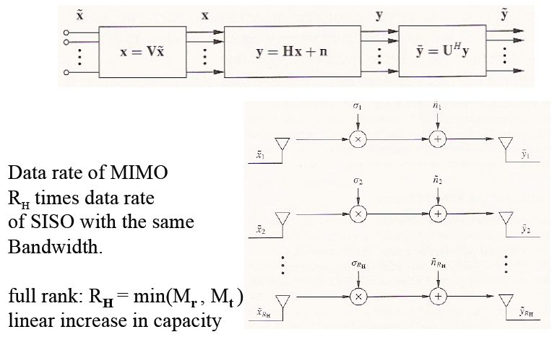
Parallel Decomposition

Slide 19
Parallel Decomposition

Slide 20
Equivalent MIMO Channel (Nt >Nr)

Slide 21
Equivalent MIMO Channel (Nr >Nt)

Slide 22
Capacity Equivqlence under Unitary Transform
Considering
Using

Slide 23
Capacity of MIMO Systems
Depends on what is known at TX and RX and if channel is static or fading
For static channel with perfect CSI at TX and RX, power water-filling over space is optimal:
In fading waterfill over space (based on short-term power constraint) or space-time (long-term constraint)
Without transmitter channel knowledge, capacity metric is based on an outage probability (static or slow fading) or ergodic capacity (fast fading)

Slide 24
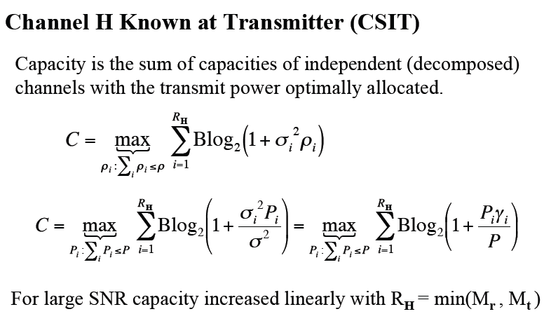


Static Channel Capacity (CSIT)

Slide 25
Static Channel Capacity (CSIT)

Slide 26


Notes
at high SNRs, the capacity is insensitive to the power allocation to sub-channels, and increases linearly with the number of degrees of freedom
at low SNRs, all power will be allocated to the parallel channel with the best CSI

Slide 27
Example

Slide 28
Static MIMO+Adaptive Modulation
子信道关系式：
和速率最大化：
最优解：

Slide 29
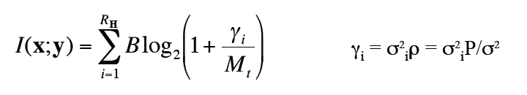
Static Channel Capacity (no CSIT)

Slide 30

For Large SNR

Slide 31
Static Channel Capacity (no CSIT)
Appropriate capacity definition is capacity with outage. In capacity with outage the transmitter fixes a transmission rate R, and the outage probability associated with R is the probability that the transmitted data will not be received correctly or, equivalently, the probability that the channel H has mutual information less than R.

Slide 32
Fading Channel Capacity (CSIT)

Slide 33
Fading Channel Capacity (CSIT)

Slide 34
Fading Channel Capacity (no CSIT)
Time-Varying Channel: Ergodic Capacity
Slowly Varying Channel: Outage Capacity

Slide 35
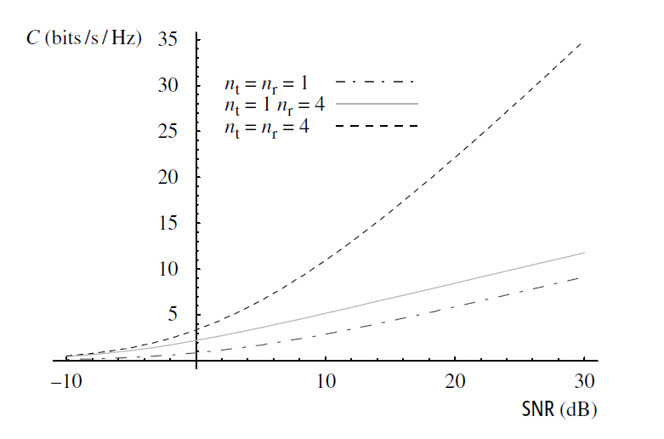
Capacity of an i.i.d. Rayleigh Fading Channel (no CSIT)

Slide 36
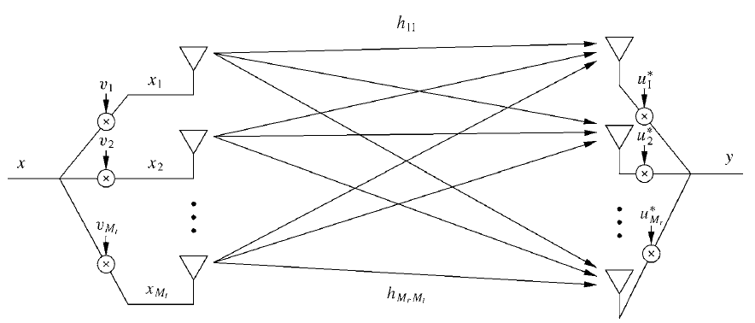
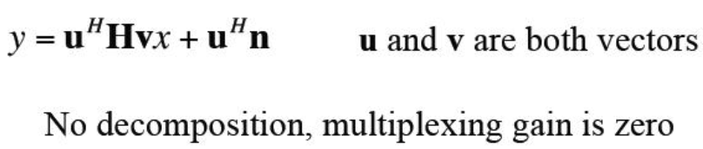
Beamforming MIMO Diversity/Array Gains

Slide 37
Solution to u and v
Set
Useful Power= ,
<=
Eqality holds when
Maximum Power= <=
Equality holds when ，

Slide 38
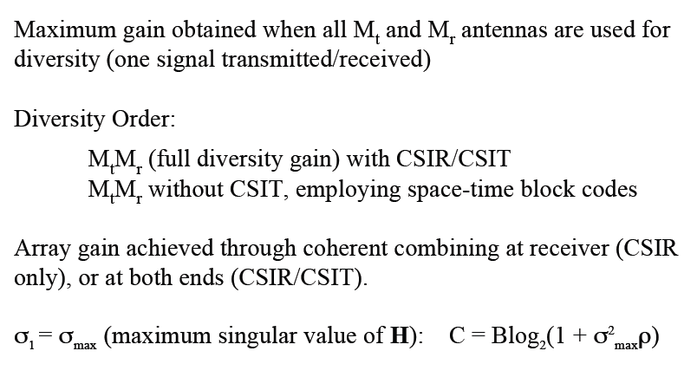
Beamforming MIMO Diversity/Array Gains

Slide 39
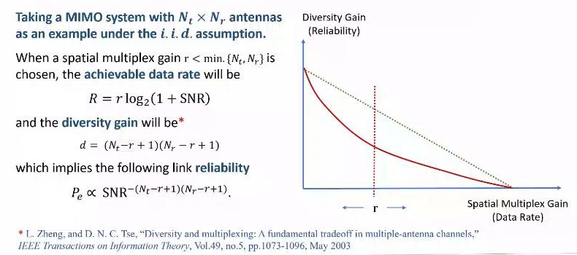
Tadeoff between Multiplexing and Diversity

Slide 40
Diversity vs. Multiplexing

Slide 41
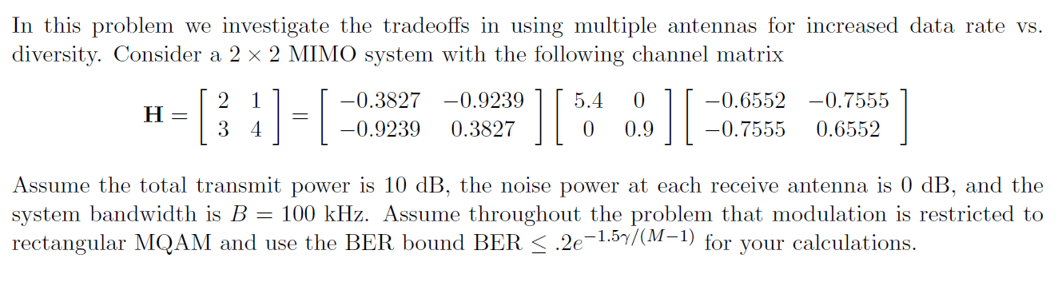
Example

Slide 42
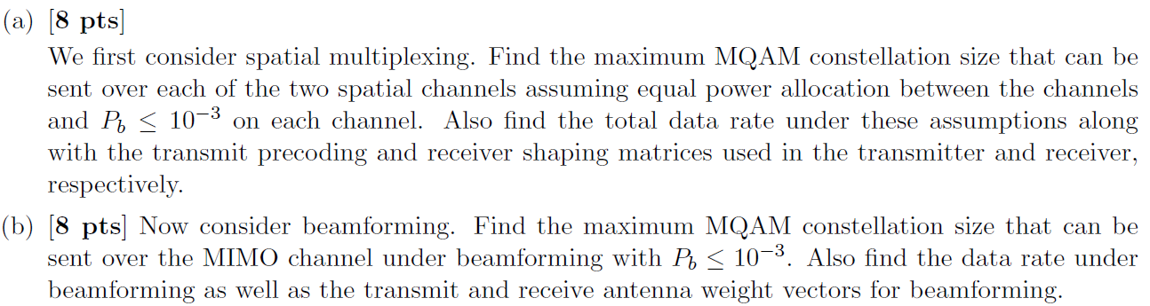

Slide 43
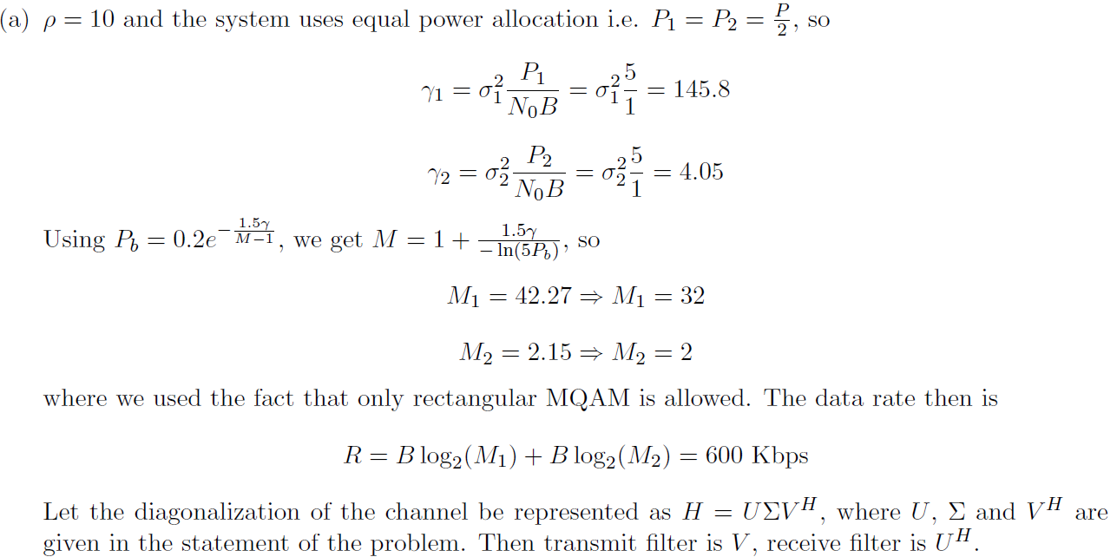
Solution

Slide 44
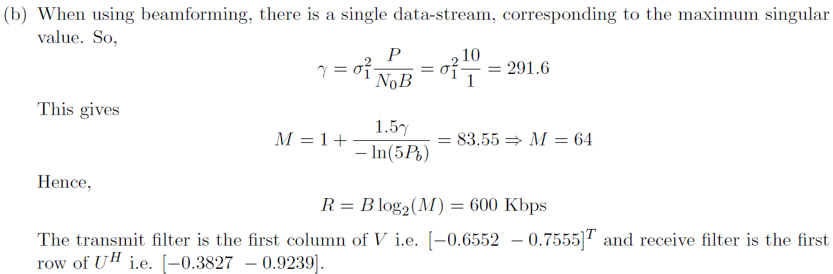

Slide 45
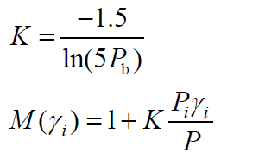
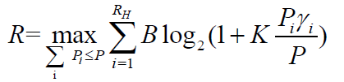
Discussion of MIMO-AMC Water-Filling Power Allocation

Slide 46
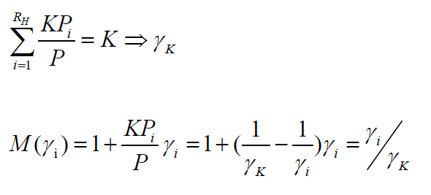
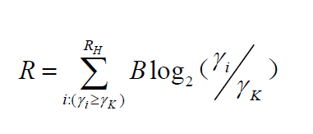
Discussion of MIMO-AMC Water-Filling Power Allocation

Slide 47
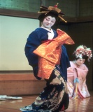
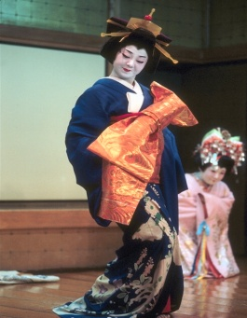

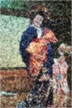

How should antennas be used?
Use antennas for multiplexing:
Use antennas for diversity
High-Rate
Quantizer
ST Code
High Rate
Decoder
Error Prone
Low-Rate
Quantizer
ST Code
High
Diversity
Decoder
Low P_{e}
Depends on end-to-end metric: Solve by optimizing app. metric

Slide 48
Main Points
MIMO channels greatly improve capacity and performance through array gain, diversity gain, interference reduction, and spatial multiplexing
MIMO channel can be decomposed into R_{H} Parallel SISO channels, where R_{H} is rank of channel matrix H
Greatest capacity improvements are obtained under rich scattering conditions (H full rank)
Capacity depends on the degree of channel knowledge at transmitter and receiver
-For static channel with CSIT and CSIR, waterfilling over space is optimal power allocation
-Similar idea in fading, based on short-term or long-term power constraint
-Without CSIT, capacity metric is based on outage probability

Slide 49
Ex. 10.6, 10.8, 10.14, 10.17

